Slide 1

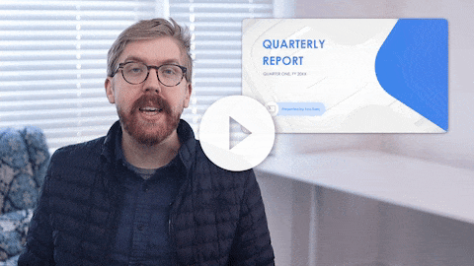
You Exec provides business resources that move your career forward. Access our full library of presentations, spreadsheet models, and business book summaries. We do the work, you take the credit.
Errors & Omissions Liability (E&O): You Exec makes no guarantee that the statements, analysis, projections, estimates, graphs, reports, numbers, and any derivatives sourced from this presentation are free of errors and omissions. You Exec assumes no liability for erroneous outcomes derived from this presentation.
Watch explainer
This video will walk you through the benefits of this framework. Paid members, please log in for a better viewing experience.

Slide 2




QUARTERLY
REPORT
QUARTER ONE, FY 20XX
Presented by You Exec

Slide 3

OVERVIEW
WELCOME
QUARTERLY REPORT
Inspire
I am delighted that the board has elected me as chairman and am ready to take our organization to the next level. As our business moves through the next decade, I can assure you that our board will continue its oversight of the company’s long-term business strategies and continue a democratic and transparent system to foster innovative thinking and problem solving.
Transform
Empower

Slide 4
OVERVIEW
VISION
To inform and inspire people around the globe through the power of unparalleled storytelling, reflecting the creative minds and innovative technologies.
CORE VALUE
We place high values on innovation and transparency. This value is delivered both in our products and services, as well as how our organization operates.
MISSION
Our mission is to allow the world to access, enjoy, & be educated by an abundance of freely shared knowledge, & in the most affordable and convenient ways.

Slide 5


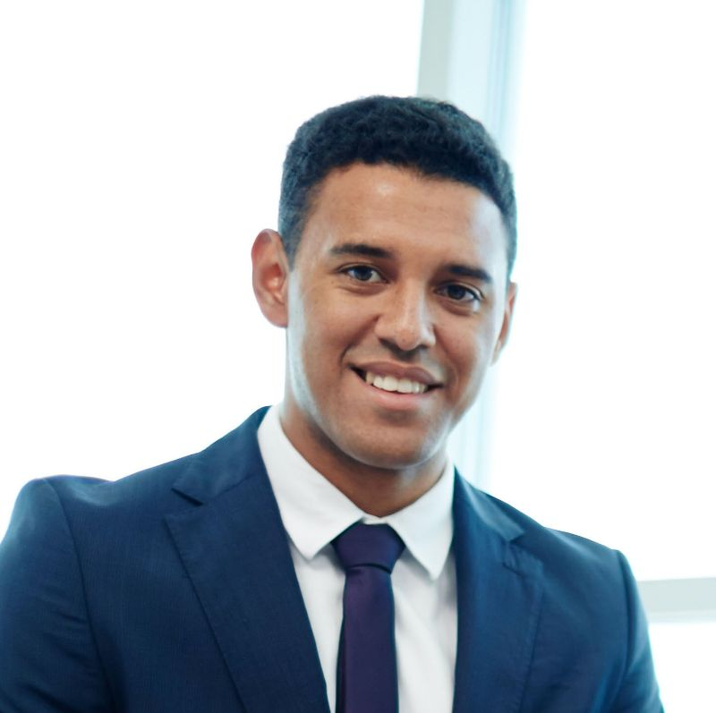

OVERVIEW
Richard Jones
Richard has successfully kept our projects on track and under budget
PROJECT LEAD
Tamara Smith
Tamara has conducted the cost-benefit analyses to ensure high ROI
PROJECT ANALYST
OUR TEAM
James Gomez
James oversaw a team of front and back end developers
ENGINEERING MNGR.
Winnie Chan
Winnie was responsible for user research and feature development
PRINCIPAL DESIGNER

Slide 6
OVERVIEW
Onboarded first executive based on newly designed hiring & HR guidelines
Introduced new IT infrastructure and resolve legacy issues
New performance
management system developed
ACHIEVEMENTS & MILESTONES
Developed restructuring blueprint and began the change management process
Launch three new products with favorable customer feedback.
Highest revenue &
Profitability in a month since Aug 20XX
Began new learning and development program for senior employees

Slide 7
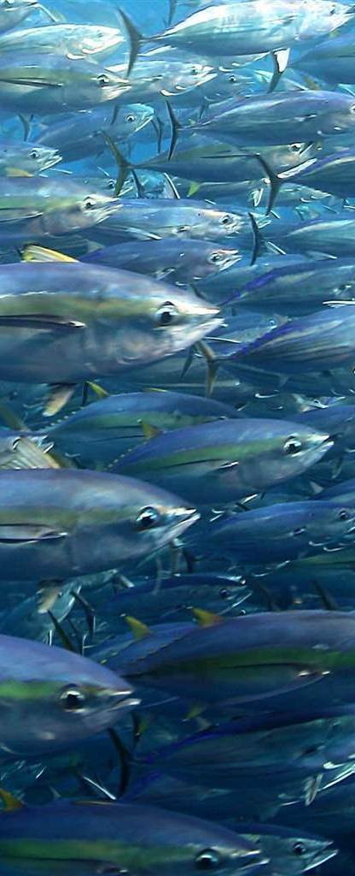
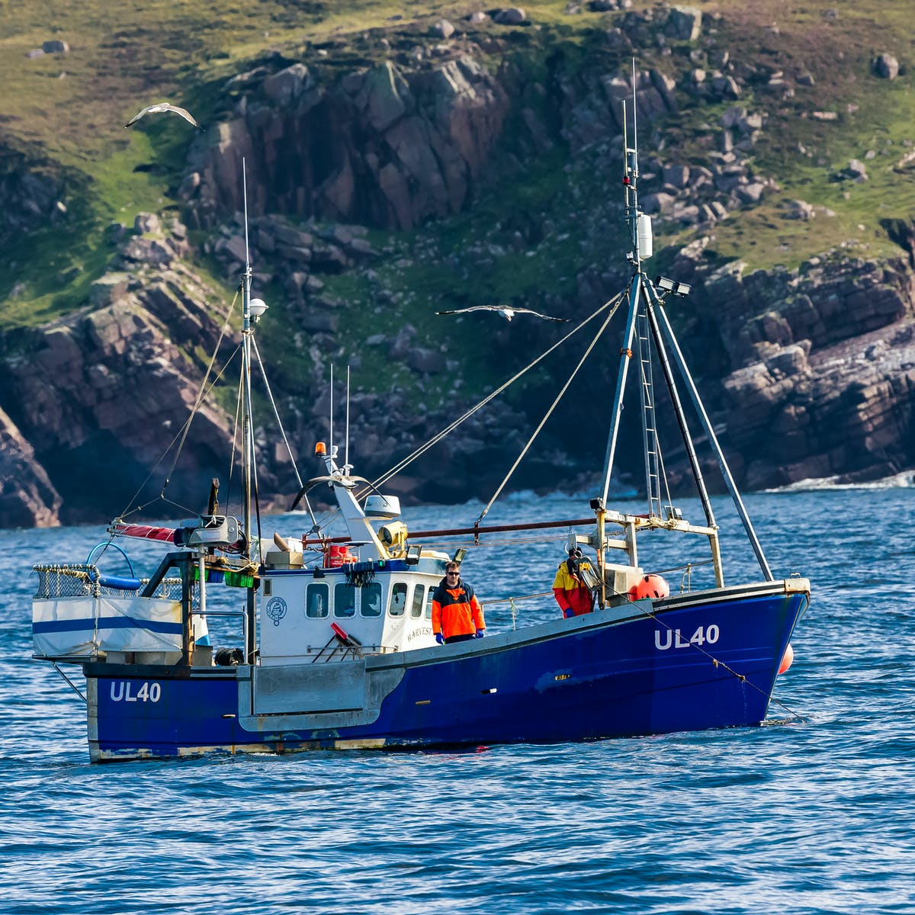
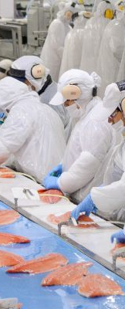
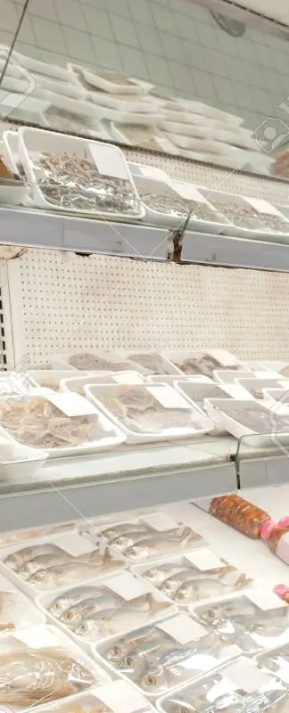

OVERVIEW
VALUE
ENABLERS
VALUE
CREATION
VALUE
CREATED
Natural
Resource
Harvesting
Processing
Sales &
Distribution
Economic Performance
Sustainable Returns
People & Safety
Empowered Team
Sustainable Raw Materials
Protected Natural Resource
Operational Capability & Capacity
Innovation & Growth
4,000,000
Kilometre squares
210
Farms
8
Processing sites
72,110
Tons export sales
Consumers & Market Access
Consumer Trust & Value

Slide 8




OVERVIEW
JEROME GARCIA
BEATRICE CHANG
DAVID LEE
This team member has over ten years of experience working on projects of all scales & sectors.
This team member has over ten years of experience working on projects of all scales & sectors.
This team member has over ten years of experience working on projects of all scales & sectors.
TEAM
RECOGNITION
TEAM LEAD
HEAD DESIGNER
PROJECT MANAGER
FIONA THOMPSON
DEAN SMITH
LINDA GOLDBERG
This team member has over ten years of experience working on projects of all scales & sectors.
This team member has over ten years of experience working on projects of all scales & sectors.
This team member has over ten years of experience working on projects of all scales & sectors.
USER RESEARCH
DATA ANALYST
ENGINEER

Slide 9

OVERVIEW
AWARDS & RECOGNITION
Accomplished product development professional with extensive experience leading teams by example. Contributed to new-hire training by helping the training department develop new materials that increased employee satisfaction and productivity by 30%.
FINANCIAL ANALYSIS
PROJECT MANAGEMENT
Jesse Roberts
75%
75%
SOFTWARE ENGINEERING
PRODUCT DESIGN
PRODUCT MANAGER
75%
75%
+001 234 567 890
yourname@domain.com

Slide 10
OVERVIEW
GEOGRAPHICAL FOOTPRINT
0.25
NORTH AMERICA
0.25
EUROPE
0.25
ASIA
0.25
AFRICA
0.25
SOUTH AMERICA
0.25
AUSTRALIA

Slide 11
FINANCIALS
AT A GLANCE
Underlying Revenue
$25,152M
Underlying Operating Profit
$1,882M
Underlying Operating Margin
7.4%
Underlying Basic Earning Per Share
85.2%
Dividend Per Share
40%
Statutory Revenue
$24,878M
Statutory Operating Profit
$1,601M
Statutory Basic Earnings Per Share
70%
Greenhouse Gas Intensity Ratio
9.1

Slide 12
FINANCIALS
60MM
Earnings before interest, taxes, depreciation,
and amortization
FINANCIAL SUMMARY
EBITA
65%
80MM
20%
10MM
NET PROFIT MARGIN
NET REVENUE
Q-o-Q GROWTH
NET PROFIT
Calculated by finding the net profit as a percentage of the revenue
Revenue minus cost of goods sold, expense & taxes for accounting
Compare current quarter to the same quarter of the previous year (Q4)
Actual profit after taking working expenses into consideration
USER RESEARCH

Slide 13
FINANCIALS
FINANCIAL RATIOS
1.5
20%
6%
0.5
20
15%
15
0.2
1.3
4%
18%
21%
P/E RATIO
DEBT TO EQUITY
CURRENT RATIO
The ratio of a company's share price to the company's earnings per share.
The relative proportion of shareholders' equity & debt used to finance.
Measures whether or not a firm has enough resources to meet its short-term obligations
RETURN ON ASSETS
RETURN ON EQUITY
RETURN ON INVESTMENT
How profitable a company's assets are in generating revenue.
The profitability of a business in relation to the equity or assets minus liabilities.
Net profit and cost of investment resulting from an investment of some resources

Slide 14
FINANCIALS
$22.0M
$14.2M
INCOME VS. EXPENSES
INCOME
EXPENSES
34%
Product sales
Overhead
74%
23%
Service upgrades
Procurement
19%
19%
Partnership commission
Marketing promotion
7%
13%
Advertising sales
11%
Team sponsorship

Slide 15
FINANCIALS
PROFIT & LOSS
Previous year
Current year
Previous year
Current year
Previous year
Current year
Previous year
Current year
18%
12%
20%
17%
Revenue CAGR
COGS CAGR
Operating Profit CAGR
Net Profit CAGR
Q2 FY 20XX - $8 MM
Q3 FY 20XX - $3 MM
Q4 FY 20XX - $4 MM
Q1 FY 20XX - $10 MM
Q2 FY 20XX - $8 MM
Q3 FY 20XX - $3 MM
Q4 FY 20XX - $4 MM
Q1 FY 20XX - $10 MM
Q2 FY 20XX - $8 MM
Q3 FY 20XX - $3 MM
Q4 FY 20XX - $4 MM
Q1 FY 20XX - $10 MM
Q2 FY 20XX - $8 MM
Q3 FY 20XX - $3 MM
Q4 FY 20XX - $4 MM
Q1 FY 20XX - $10 MM

Slide 16
FINANCIALS
PROFIT & LOSS
Q1 FY 20XX
Q2 FY 20XX
Q3 FY 20XX
Q4 FY 20XX
Net Sales | 1,703.1 | 2,022.0 | 3,184.5 | 3,476.6
Other Income | 4.0 | 9.9 | 11.8 | 31.8
Total Income | 1,707.2 | 2,031.9 | 3,196.3 | 3,508.4
Expenses | 445.4 | 512.0 | 556.8 | 715.0
Total Material Consumed | 1,282.5 | 1,374.7 | 2,028.2 | 2,200.4
Employee Benefit Expense | 92.1 | 128.4 | 155.6 | 226.5
Other Expenses | 71.2 | 167.3 | 265.6 | 299.7
EBITDA | 261.3 | 361.6 | 746.9 | 781.8
% EBITDA | 15.3% | 17.8% | 23.4% | 22.3%
Depreciation Expense | 28.4 | 45.8 | 60.0 | 69.3
Financing Cost | 66.9 | 128.8 | 198.1 | 273.9
Profit Before Tax | 166.0 | 186.9 | 488.8 | 438.5
Taxes | 4.0 | -0.8 | 138.8 | 100.8
Profit After Tax | 162.0 | 187.7 | 350.0 | 337.7
% PAT | 9.5% | 9.2% | 11.0% | 9.6%

Slide 17
FINANCIALS
BALANCE SHEET
Shareholders‘ Equity
Non–current Liabilities
Short–term Borrowings
Trade Payables
Other Current Liabilities
Short Term Provisions
Current Liabilities
Total Liabilities
 | Q1 FY 20XX |  | Q2 FY 20XX |  | Q3 FY 20XX |  | Q4 FY 20XX
 | 529.8 |  | 1,067.8 |  | 1,294.6 |  | 1,632.4
 | 535.0 |  | 548.2 |  | 513.5 |  | 989.0
 | 439.8 |  | 622.7 |  | 720.6 |  | 1,603.8
 | 352.9 |  | 508.9 |  | 760.4 |  | 433.7
 | 5.9 |  | 147.3 |  | 289.5 |  | 372.6
 | 21.4 |  | 6.2 |  | 15.0 |  | 28.0
 | 820.1 |  | 1,285.0 |  | 1,785.5 |  | 2,438.1
 | 1,760.4 |  | 2,678.1 |  | 3,316.3 |  | 4,730.4

Slide 18
 |  | Q1 FY 20XX |  | Q2 FY 20XX |  | Q3 FY 20XX |  | Q4 FY 20XX
Total Fixed Assets |  | 803.2 |  | 1,034.6 |  | 1,159.5 |  | 1,751.3
Non–current Investments |  | 26.6 |  | 26.6 |  | 104.5 |  | 26.6
Long Term Loans And Advances |  | - |  | 8.0 |  | 73.4 |  | 204.8
Other Non–current Assets |  | - |  | 13.8 |  | - |  | -
Current Investments |  | - |  | - |  | - |  | 77.9
Inventories |  | 341.3 |  | 731.3 |  | 771.3 |  | 1,215.8
Trade Receivables |  | 477.6 |  | 605.1 |  | 996.1 |  | 1,061.3
Cash And Bank Balances |  | 33.0 |  | 89.5 |  | 132.2 |  | 258.8
Short–term Loans & Advances |  | 75.8 |  | 169.1 |  | 76.9 |  | 131.6
Other Current Assets |  | 2.9 |  | 0.0 |  | 2.3 |  | 2.4
Current Assets |  | 930.5 |  | 1,595.1 |  | 1,978.8 |  | 2,747.8
Total Assets |  | 1,760.4 |  | 2,678.1 |  | 3,316.3 |  | 4,730.4
FINANCIALS

Slide 19
FINANCIALS
Operating activity
20% CAGR
Financing activity
15% CAGR
Investing activity
17% CAGR
Net income in cash
CASH FLOW
STATEMENT
6% CAGR
 | Q1 FY 20XX | Q2 FY 20XX | Q3 FY 20XX | Q4 FY 20XX
Operations | 8MM | 6MM | 4MM | 6MM
Financing Activities | 4MM | 5MM | 3MM | 7MM
Investing Activities | 4MM | 3MM | 2MM | 3MM
Net Income in Cash | 3MM | 3MM | 2MM | 3MM

Slide 20
FINANCIALS
CASH FLOW STATEMENT
Q1 FY 20XX
Q2 FY 20XX
Q3 FY 20XX
Q4 FY 20XX
CASH FLOW FROM OPERATING ACTIVITIES
3,184
3,467
4,621
6,168
CASH FLOW FROM INVESTING ACTIVITIES
3,184
3,467
4,621
6.168
CASH FLOW FROM FINANCING ACTIVITIES
3,184
3,467
4,621
6.168
CHANGE IN CASH & CASH EQUIVALENTS
3,184
3,467
4,621
6.168

Slide 21
FINANCIALS
FUNDING UPDATES - DEBT
ANNUAL LIMITS 20XX
$ XX MM APPRAISED BY BANK NAME
 | FBWCL |  | NFBWCL |  | TOTAL
BANK 01 | 85 | 40.5% | 171 | 32.6% | 256 | 34.8%
BANK 02 | 41 | 19.5% | 34 | 6.5% | 75 | 10.2%
BANK 03 | 15 | 7.1% | 60 | 11.4% | 75 | 10.2%
BANK 04 | 0 | 0.0% | 30 | 5.7% | 30 | 4.1%
BANK 05 | 12 | 5.7% | 33 | 6.3% | 45 | 6.1%
BANK 06 | 3 | 1.4% | 14 | 2.7% | 17 | 2.3%
BANK 07 | 12 | 5.7% | 60 | 11.4% | 72 | 9.8%
BANK 08 | 8 | 3.8% | 35 | 6.7% | 43 | 5.9%
BANK 09 | 4 | 1.9% | 53 | 10.1% | 57 | 7.8%
BANK 10 | 15 | 7.1% | 15 | 2.9% | 30 | 4.1%
BANK 11 | 15 | 7.1% | 20 | 3.8% | 35 | 4.8%
TOTAL | 210 | 100% | 525 | 100% | 735 | 100%

Slide 22
FINANCIALS
FUNDING UPDATES
SHAREHOLDER NAME | SHAREHOLDING PATTERN
 | TOTAL SHARES | PERCENTAGE (%)
NAME 1 | 85 | 40.5%
NAME 2 | 41 | 19.5%
NAME 3 | 15 | 7.1%
NAME 4 | 0 | 0.0%
NAME 5 | 12 | 5.7%
NAME 6 | 3 | 1.4%
NAME 7 | 12 | 5.7%
NAME 8 | 8 | 3.8%
NAME 9 | 4 | 1.9%
NAME 10 | 15 | 7.1%
NAME 11 | 15 | 7.1%
TOTAL | 210 | 100%

Slide 23
OTHER UPDATES
23%
45%
70%
MARKET SHARE
Our Company
75%
Competitor 01
Competitor 02
Competitor 03

Slide 24

OTHER UPDATES
MAJOR CLIENTS ACQUIRED
ABC CO.
GHI CO.
MNO LTD.
It is the leader in tech and can bring more revenue for us
It has big spending budget and can improve our sales
It has many affiliated entities to refer our business too
DEF CO.
JKL CO.
It has a positive public image and improve our public relations for us
It provides further learning to our consultants who work on its projects

Slide 25
OTHER UPDATES
PROJECT UPDATES
PROJECTS BAGGED
PROJECTS IN HANDS
PROJECTS LOST
PIPELINE ORDERS
AMOUNT
AMOUNT
AMOUNT
AMOUNT
PROJECT NAME 01
20 K
20 K
20 K
20 K
PROJECT NAME 02
60 K
60 K
60 K
60 K
PROJECT NAME 03
1 MM
1 MM
1 MM
1 MM
PROJECT NAME 04
87 K
87 K
87 K
87 K
PROJECT NAME 05
2 MM
2 MM
2 MM
2 MM

Slide 26
OTHER UPDATES
MARKETING ACTIVITY
FAN GROWTH
FAN GROWTH
FAN GROWTH
7.66%
12.86%
4.50%
14,000 Fans Added
5000 Engaged
35 Post
7600 Likes
14,000 Fans Added
5000 Engaged
35 Post
7600 Likes
14,000 Fans Added
5000 Engaged
35 Post
7600 Likes
SHARE OF ENGAGEMENT
SHARE OF ENGAGEMENT
SHARE OF ENGAGEMENT
32%
52%
13%
Of engagement
Of engagement
Of engagement

Slide 27
OTHER UPDATES
Helped to add 2,500 jobs worldwide
Assisted eligible applicants worldwide with our job skills program/training & consulting
LEARNING & DEVELOPMENT
65% hired applicants were women
Our company promotes equal
opportunities for women and minorities
Technical Specialist Programs
2,800
Communication & Language
2,385
Total 86,542 hours of job skills training
Traversal Skills Training
1,950
Provide our clients with learning solutions and job skills program/training worldwide
Apprenticeship Training
1,845

Slide 28
OTHER UPDATES
SOCIAL RESPONSIBILITY
PEOPLE
Supporting the wellbeing of our team members, guests, and communities
$7.32B
Distributed $7.32 billion in economic wealth to our stakeholders, helping improve lives in our communities
$67M
Invested $67 million in our communities in 20XX, including >373,000 hours volunteered by our team members
PLANET
Taking care of the world we all call home
-19.7%
Achieved a 19.7% reduction in absolute Scope 1&2 emissions versus 2011, reaching 64% of our 2025 science-based emissions reduction target
A & A-
Scored A for climate and A- for water in CDP questionnaires', raking our company as a top climate performer in our industry
-39%
Maintained safety performance in 20XX amounting to a 39% improvement in injury rate since 20XX
1.5M
Provide 1.5 million hours of training to our team members in 20XX – more than 27 hours per team member per year
46
Turned every dollar of revenue into a contribution to its communities of 46 cents – almost 4 times the average community contribution for U.S corporation
43%
Diverted 43$ of all our waste from landfill
-3%
Reduced water use per 1,000 sq.ft. at our properties by 3% in 20XX
40,000
Reaching more than 40,000 charging sessions resulting in more than 500 tons of GHG emissions through our electric vehicle charging stations

Slide 29
GOALS
NEXT QUARTER GOALS
OBJECTIVES
WHAT IT MEANS
TO US
KEY INITIATIVES
Raw materials heat the centre of our business and their utilisation must not exceed the capacity to replenish. It is increasingly important for us to continue optimising the value of this precious resource.
Understand current cost of everything we do
Increase the returns on all raw materials through value stream mapping
Build organisational flexibility
Develop our collaboration both eternally and externally & build strategic alliances
Optimize value of
raw materials
Create a culture of innovation
Innovation requires a culture of idea generation. With our targets to set global benchmarks in the field.
Stimulate idea generation
Introduce research and development key performance indicators
Benchmark against leading innovators
Develop precise and relevant specifications
Align rewards with effective communication trailing and performance
Duality assessment system to be appropriate
Sharing al customer feedback
Create quality culture
Consistently produce quality products
Implement a companywide focus on quality to preserve the inherent quality of our natural resources through the supply chain.
By placing our values both internally and in the public sphere. We aim to become the employer of choice and enhance our overall brand.
Enhance public image
Develop visibly
Live our values
Employer of choice
Enhance our brand

Slide 30
GOALS
RATIOS | YEAR 1 | YEAR 2 | YEAR 3 | YEAR 4 | YEAR 5
Profitability (Net income / Revenue) | 0.80% | 6.40% | 13.40% | 19.70% | 20.70%
Efficiency(Revenue /Assets) | 1.28 | 1.00 | 1.34 | 1.74 | 1.69
Leverage (Liabilities/Assets) | 50.90% | 66.40% | 48.40% | 32.10% | 20.90%
Operating return on assets (ROA) | 3.20% | 11% | 24.60% | 43.70% | 44.10%
Return on equity (ROE) | 2.10% | 19.10% | 34.80% | 50.60% | 44.40%
Liquidity(Current assets /Current liability) | 1.97 | 2.03 | 2.30 | 3.08 | 3.51
BREAKEVEN REVENUE | $39,273.00 | $64,087.00 | $69,481.00 | $110,247.00 | $158,603.00
REVENUE
NET INCOME
CASH BALANCE
FREE CASH FLOW
(CUMULATIVE)

Slide 31
GOALS
SALES PROJECTION
 |  | NEW BUSINESS |  |  |  | REORDERS |  |  |  | TOTALS
 |  | GOAL | ACTUAL | VARIANCE |  | GOAL | ACTUAL | VARIANCE |  | GOAL | ACTUAL | VARIANCE
JANUARY |  | 199 | 145 | -27.% |  | 85 | 105 | 24.% |  | 284 | 250 | -12.00%
FEBRUARY |  | 166 | 238 | 43.% |  | 105 | 108 | 3.% |  | 271 | 346 | 27.70%
MARCH |  | 204 | 152 | -26.% |  | 90 | 71 | -21.% |  | 294 | 223 | -24.%
APRIL |  | 224 | 291 | 30.% |  | 89 | 78 | -12.% |  | 313 | 369 | 17.90%
MAY |  | 290 | 158 | -46.% |  | 85 | 76 | -11.% |  | 375 | 234 | -37.60%
JUNE |  | 138 | 272 | 97.% |  | 80 | 87 | 9.% |  | 218 | 359 | 65.%
JULY |  | 154 | 255 | 66.% |  | 73 | 74 | 1.% |  | 227 | 329 | 45.%
AUGUST |  | 268 | 207 | -23.% |  | 73 | 108 | 48.% |  | 341 | 315 | -7.60%
SEPTEMBER |  | 294 | 284 | -3.% |  | 78 | 86 | 10.% |  | 372 | 370 | -0.50%
OCTOBER |  | 249 | 213 | -15.% |  | 102 | 72 | -29.% |  | 351 | 285 | -18.80%
NOVEMBER |  | 153 | 278 | 82.% |  | 106 | 93 | -12.% |  | 259 | 371 | 43.20%
DECEMBER |  | 286 | 148 | -48.% |  | 97 | 98 | 1.00% |  | 383 | 246 | -36.%
TOTAL |  | 2,625 | 2641. | 0.6% |  | 1,063 | 1,056 | -0.70% |  | 3,688 | 3,697 | 0.2%

Slide 32
TIMELINE
12-MONTH ROADMAP
FY 20XX
MAY
Begin performance review with every member of the Sales team and low performance are to have meetings first.
MAR
Onboard at lease one new executive under new hiring and HR guidelines.
JAN
Review 20XX annual performance and discuss key learnings and takeaways.
11
09
07
10
12
08
JUN
New product launch plan proposed & survey group scheduled
APR
Finalize proposals on technological revamp that was submitted and revised last year.
FEB
Inter-departmental meetings commence, & improvement proposals revised.

Slide 33
TIMELINE
12-MONTH ROADMAP (CONT.)
FY 20XX
NOV
Begin performance review with every member of the Sales team and low performance are to have meetings first.
SEP
Onboard at lease one new executive under new hiring and HR guidelines.
JUL
Review 20XX annual performance & discuss key learnings and takeaways.
11
09
12
07
10
08
DEC
New product launch plan proposed & survey group scheduled
OCT
Finalize proposals on technological revamp that was submitted and revised last year.
AUG
Inter-departmental meetings commence, & improvement proposals revised.

Slide 34
TIMELINE
12-MONTH ROADMAP
JAN
FEB
MAR
APR
MAY
JUN
JUL
AUG
SEP
OCT
NOV
DEC
MILESTONE
Management Offsite
Phase One Completed
All Hands Launch
Public Launch
Phase Two Completed
LEADERSHIP
Goal Setting + KPI’s
Team Restructure
Term Incentives
Implement Feedback
Communicated Vision
Resource Allocation
Long-term KPI’s
Budgeting
OPERATIONS
Infrastructure Review
Create Timeline
Build New Infrastructure
Brainstorming
Implement Tools
Cashflow review
Data Aggregation
Data Analysis
Risk Analysis
New Billing System
MARKETING
Competitive Analysis
Public Launch
PR Campaign
HR MGMT.
Employee Feedback
HR Handbook
Enforce Policies
Research Consulting Firms
Team Preparedness
Team Offsites
Employee feedback

Slide 35
CALENDAR
HOLIDAY & OBSERVANCES
JANUARY
S | M | T | W | T | F | S
 |  |  |  |  |  | 1
2 | 3 | 4 | 5 | 6 | 7 | 8
9 | 10 | 11 | 12 | 13 | 14 | 15
16 | 17 | 18 | 19 | 20 | 21 | 22
23 | 24 | 25 | 26 | 27 | 28 | 29
30 | 31
FEBRUARY
S | M | T | W | T | F | S
 |  | 1 | 2 | 3 | 4 | 5
6 | 7 | 8 | 9 | 10 | 11 | 12
13 | 14 | 15 | 16 | 17 | 18 | 19
20 | 21 | 22 | 23 | 24 | 25 | 26
27 | 28
MARCH
S | M | T | W | T | F | S
 |  | 1 | 2 | 3 | 4 | 5
6 | 7 | 8 | 9 | 10 | 11 | 12
13 | 14 | 15 | 16 | 17 | 18 | 19
20 | 21 | 22 | 23 | 24 | 25 | 26
27 | 28 | 29 | 30 | 31
APRIL
S | M | T | W | T | F | S
 |  |  |  |  | 1 | 2
3 | 4 | 5 | 6 | 7 | 8 | 9
10 | 11 | 12 | 13 | 14 | 15 | 16
17 | 18 | 19 | 20 | 21 | 22 | 23
24 | 25 | 26 | 27 | 28 | 29 | 30
Jan 01 Now Year’s Day
Jan 17 Martin Usher King Day
Feb 01 Chinese New Year
Feb 12 Lincoln's Birthday
Feb 14 Valentine's Day
Feb 71 Presidents Day
Mar 02 Ash Wednesday
Mar 13 Daylight Sag (begin)
Mar 17 St Patrick's Day
Mar 20 Vernal equinox
Apr 01 April Fools Day
Apr 03 Ramadan began
Apr 16 Passover
Apr 17 Easter
Apr 27 Admin Assistants Day
May 08 Mother's Day
May 30 Mammal Day
Jun 05 Pentecost
Jun 14 Flag Day
Jun 19 Fathers Day
Jun 21 June Solstice
Jul 04 Independence Day
Sep 05 Labor Day
Sep 23 Autumnal equinox
Sep 26 Rosh Hashanah
Oct 10 Columbus Day
Oct 31 Halloween
Nov 06 Daylight Swing rend)
Nov 11 Veterans Day
Nov 24 Thanksgiving
Dec 18 Hanukkah begins
Dec 21 December Solstice
Dec 25 Christmas Day
Dec 26 Kwanzaa begets
Dec 31 New Year’s Eve
MAY
S | M | T | W | T | F | S
1 | 2 | 3 | 4 | 5 | 6 | 7
8 | 9 | 10 | 11 | 12 | 13 | 14
15 | 16 | 17 | 18 | 19 | 20 | 21
22 | 23 | 24 | 25 | 26 | 27 | 28
29 | 30 | 31
JUNE
S | M | T | W | T | F | S
 |  |  | 1 | 2 | 3 | 4
5 | 6 | 7 | 8 | 9 | 10 | 11
12 | 13 | 14 | 15 | 16 | 17 | 18
19 | 20 | 21 | 22 | 23 | 24 | 25
26 | 27 | 28 | 29 | 30
JULY
S | M | T | W | T | F | S
 |  |  |  |  | 1 | 2
3 | 4 | 5 | 6 | 7 | 8 | 9
10 | 11 | 12 | 13 | 14 | 15 | 16
17 | 18 | 19 | 20 | 21 | 22 | 23
24 | 25 | 26 | 27 | 28 | 29 | 30
31
AUGUST
S | M | T | W | T | F | S
 | 1 | 2 | 3 | 4 | 5 | 6
7 | 8 | 9 | 10 | 11 | 12 | 13
14 | 15 | 16 | 17 | 18 | 19 | 20
21 | 22 | 23 | 24 | 25 | 26 | 27
28 | 29 | 30 | 31
SEPTEMBER
S | M | T | W | T | F | S
 |  |  |  | 1 | 2 | 3
4 | 5 | 6 | 7 | 8 | 9 | 10
11 | 12 | 13 | 14 | 15 | 16 | 17
18 | 19 | 20 | 21 | 22 | 23 | 24
25 | 26 | 27 | 28 | 29 | 30
OCTOBER
S | M | T | W | T | F | S
 |  |  |  |  |  | 1
2 | 3 | 4 | 5 | 6 | 7 | 8
9 | 10 | 11 | 12 | 13 | 14 | 15
16 | 17 | 18 | 19 | 20 | 21 | 22
23 | 24 | 25 | 26 | 27 | 28 | 29
30 | 31
NOVEMBER
S | M | T | W | T | F | S
 |  | 1 | 2 | 3 | 4 | 5
6 | 7 | 8 | 9 | 10 | 11 | 12
13 | 14 | 15 | 16 | 17 | 18 | 19
20 | 21 | 22 | 23 | 24 | 25 | 26
27 | 28 | 29 | 30
DECEMBER
S | M | T | W | T | F | S
 |  |  |  | 1 | 2 | 3
4 | 5 | 6 | 7 | 8 | 9 | 10
11 | 12 | 13 | 14 | 15 | 16 | 17
18 | 19 | 20 | 21 | 22 | 23 | 24
25 | 26 | 27 | 28 | 29 | 30 | 31

Slide 36
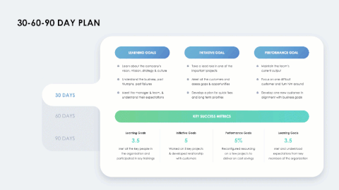



Related
The following resources are related to this framework and can save you hours of work.
If you’re a free or paid member, log into You Exec first for a better download experience.
30-60-90 Day Plan
2022 Calendar
Graphs & Charts
Objectives & Key Results

